Slide 1
CopyCat Architecture
Hofstadter, Douglas R., and Melanie Mitchell. "The copycat project: A model of mental fluidity and analogy-making." Advances in connectionist and neural computation theory 2, no. 31-112 (1994): 29-30.
Copycat is a program designed to discover “insightful” analogies in a psychologically realistic way
Example: “abc” is to “bcd” as “ijk” is to “?”
Example: “aabc” is to “aabd” as “ijkk” is to “?”
The LIDA concept of structure building codelets was inspired by the Copycat architecture

Slide 2
CopyCat Architecture
Three main components:
Slipnet – Long Term Memory
Workspace – Short Term / Working Memory
Coderack – Codelet “waiting room”
Add “top-down” codelets
Coderack
Codelet Pool
Slipnet
3
1
Permanent Concepts
codelet
A codelet is probabilistically selected from the codelet pool for execution
“effector codelets” modify perceptual structures in the workspace; “scout codelets” scan for sought content
“scout codelets” add new codelets to the pool
2
Send active concepts
Workspace
Temporary
Perceptual
Structures
Modify slipnet

Slide 3
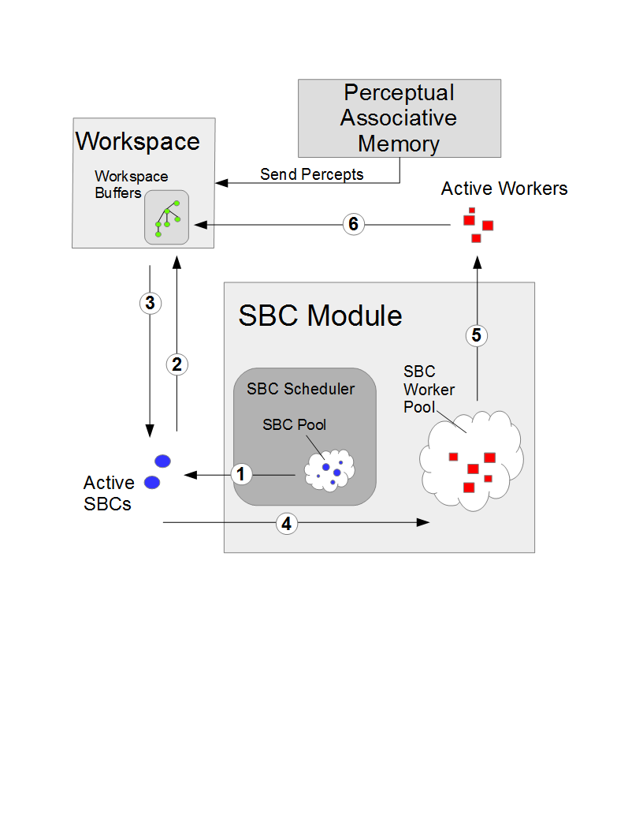
LIDA: Workspace and SBC Enhancements
Notes:
SBC scheduling based on base-level activation.

Slide 4
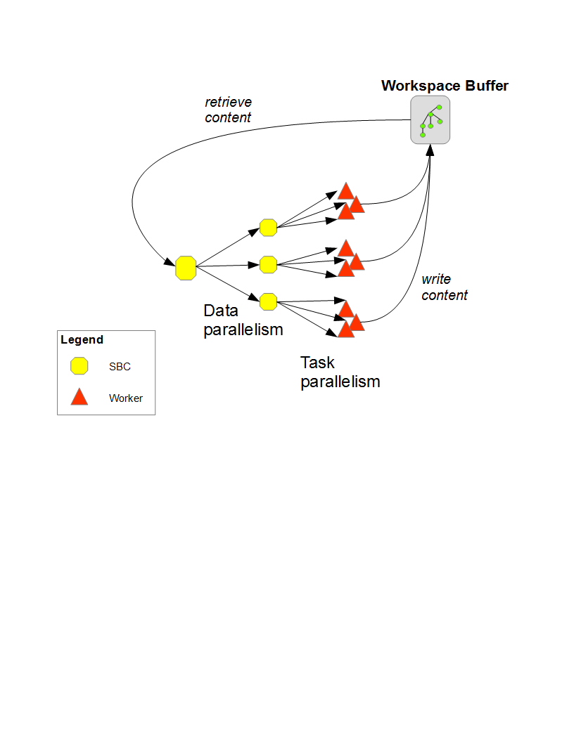
LIDA: Workspace and SBC Enhancements

Slide 5
LIDA: Workspace
Workspace implementation guarantees:
Concurrent reads, exclusive writes
Links exist only when linked content exists in the buffer
Link creation/removal is an atomic event
No duplicates of identical content or links
Gracefully handle issues caused by stale read states
Multiple adds of same content
Remove request when content has already been removed

Slide 6
SBC Module
SBC Scheduler
Fixed-size SBC thread pool
SBCs are probabilistically selected for execution based on their base-level activation
SBC Worker Pool
Variable-size worker thread pool
Properties:
Configurable max active worker threads
Additional requests to worker pool are placed in a bounded request queue
If bounded request queue capacity exceeded a reject policy is invoked

Slide 7
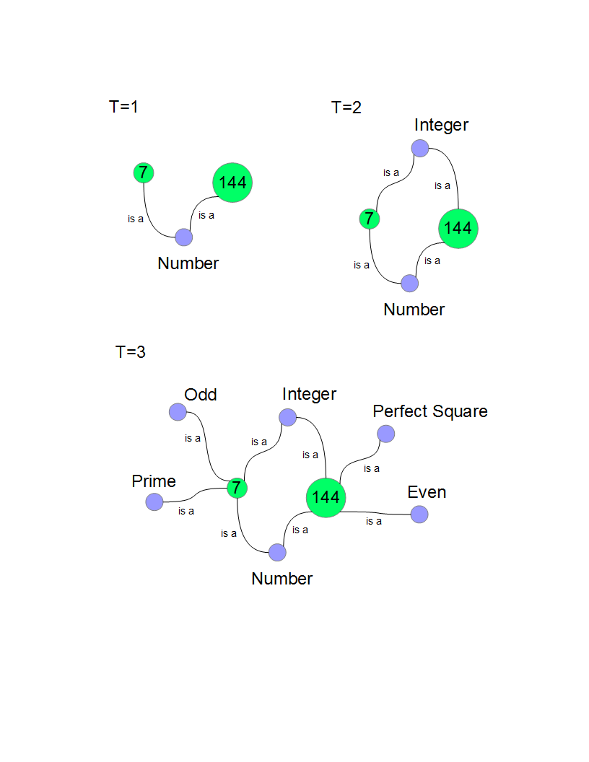
Evaluation: Correctness
Expected workspace buffer contents
Workspace guarantees are enforced (synchronization)
SBC scheduling working properly

